Slide 1
3D Vision
20 December, 2018
Ajad Chhatkuli¹ and Bishesh Khanal²
1 ETH Zürich, Switzerland; NAAMII, Nepal
2 King’s/Imperial College London, UK; NAAMII, Nepal

Slide 2
Computer Vision – 3D Vision
What can you tell about the 3D object from their images?
Pattern Recognition – image pixel colors
3D vision – Pixel locations from projection
Main reference: Multiple View Geometry, [Hartley and Zisserman, 2004]

Slide 3
Pinhole Camera model
Camera Projection
The pin-hole camera model
Image plane cuts the rays

Slide 4
The Image plane
Camera Projection
You can put the image plane anywhere
Simpler to model if it assumed on the front at distance 1.
Image plane cuts the rays

Slide 5
The Image plane
Camera Projection
You can put the image plane anywhere
Simpler to model if it is assumed on the front at distance 1.
Image plane cuts the rays
O
Any difference?

Slide 6
Camera axis
Assume orientations
Z – axis passes perpendicular to the image plane
x
O
z
y
Focal length = 1

Slide 7
Image coordinates
Projection equations
Image plane coordinate system
Can you prove them? – Exercise!
O
z
u
v
What kind of equations are they?

Slide 8
Image coordinates
Linear form
Homogeneous coordinates
Although 3 elements are used they represent projected points in 2D!
O
u
v
Homogeneous coordinates!

Slide 9
Image coordinates
Linear form
Homogeneous coordinates
Same for the 3D points!
O
u
v
Homogeneous coordinates!

Slide 10
Projection matrix
Linear form
Homogeneous coordinates
Same for the 3D points!
O
Verify:
u
v

Slide 11
Your cameras are different!
Image origin is at the top left
This changes the projection equation!
Introduce the camera calibration matrix
u
v
O

Slide 12
Your cameras are different!
The focal length is much greater than 1 pixel.
Scale the image coordinates.
u
v
O

Slide 13
Two-view geometry
Two pinhole cameras
Epipolar geometry
Camera 1
Camera 2

Slide 14
Two-view geometry
Two pinhole cameras
Epipolar geometry
Epipolar Plane
Camera 1
Camera 2

Slide 15


Two-view geometry
Two pinhole cameras
Corresponding points
Epipolar Plane
Camera 1
Camera 2

Slide 16
Two-view geometry
Camera 2 has been rotated and translated.
Corresponding points
Camera 1
Camera 2

Slide 17
Two-view geometry
Camera 1
Camera 2

Slide 18
Two-view geometry
Camera 1
Camera 2

Slide 19
The Essential Matrix
Essential matrix is:
Rank 2 matrix
2 equal non-zero singular values
What about the last singular value?

Slide 20
The Essential Matrix
True for all corresponding points:
Mathematically,

Slide 21
The Fundamental matrix
For cameras with different focal length and principal point
Too many equations!!

Slide 22
The Fundamental matrix
For all corresponding points:
Properties:
Lets discuss!! What does it mean by the rank being 2?

Slide 23
The 8-point Method
Given many correspondences, compute
Requires at least 8 points to solve!

Slide 24
The 8-point Method
Given many correspondences, compute

Slide 25
The 8-point Method
Given many correspondences, compute

Slide 26
The 5-point Method
Can you do better for the Essential matrix?
Matrix constraint

Slide 27
Triangulation
Obtain 3D from 2D images

Slide 28
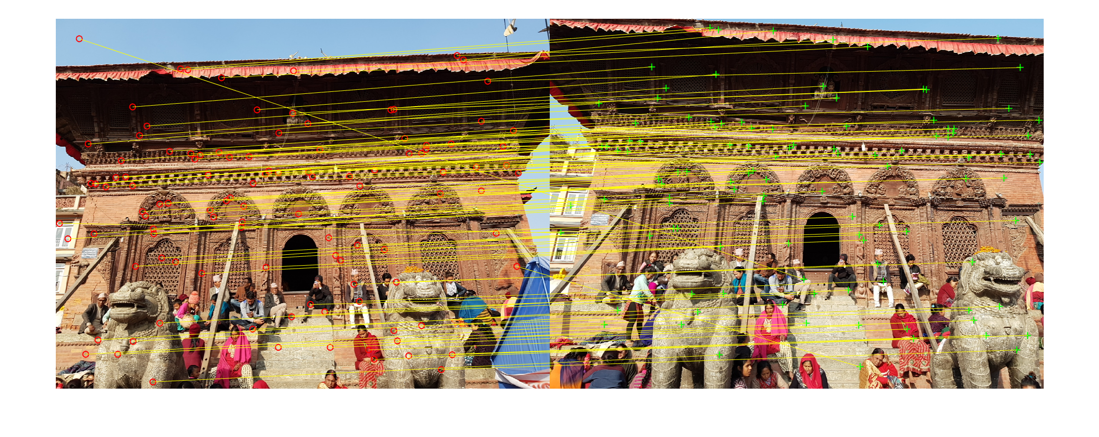
Corresponding points
Find “keypoints” in images
Scale Invariant Feature Transform (SIFT) – [Lowe, 2004]
Returns “most unique” points in images

Slide 29



SIFT
Scale Invariant Feature Transform [Lowe 2004]

Slide 30
SIFT
Scale Invariant Feature Transform

Slide 31
Structure-from-Motion
Multi-view triangulation
Triangulate with two views
Transfer points to common reference
Minimize triangulation error – Bundle adjustment
Sparse 3D points
Compute dense 3D points

Slide 32
Structure-from-Motion
Pose computation

Slide 33
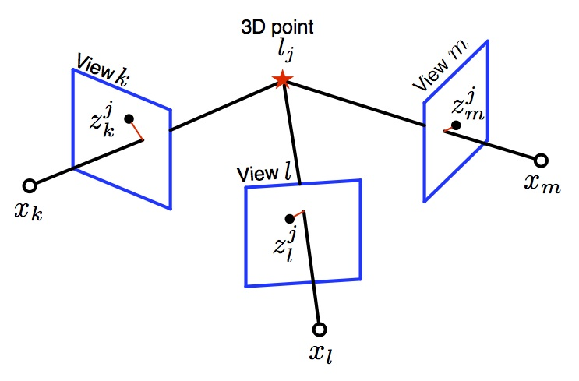
Structure-from-Motion
Multi-view triangulation
Source: Vadim Indelman, ANPL

